Slide 1
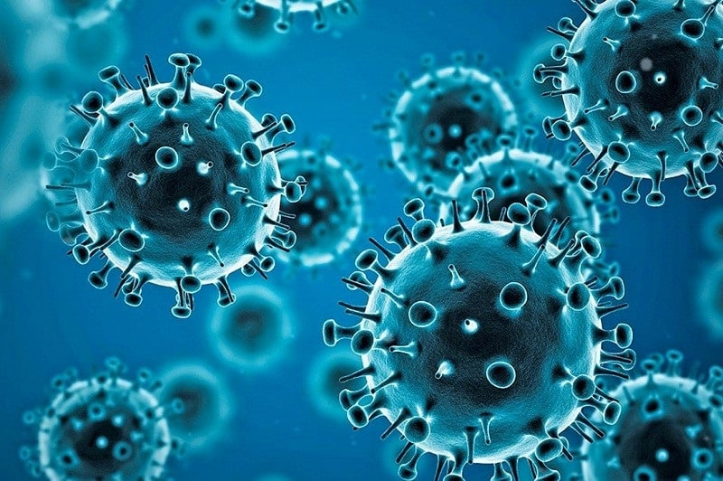
Copper's Antimicrobial Properties in Combating COVID-19
By: Marziyye qasemi
Chemical Engineering - Biotechnology and Pharmaceutical
OCT 2024

Slide 2
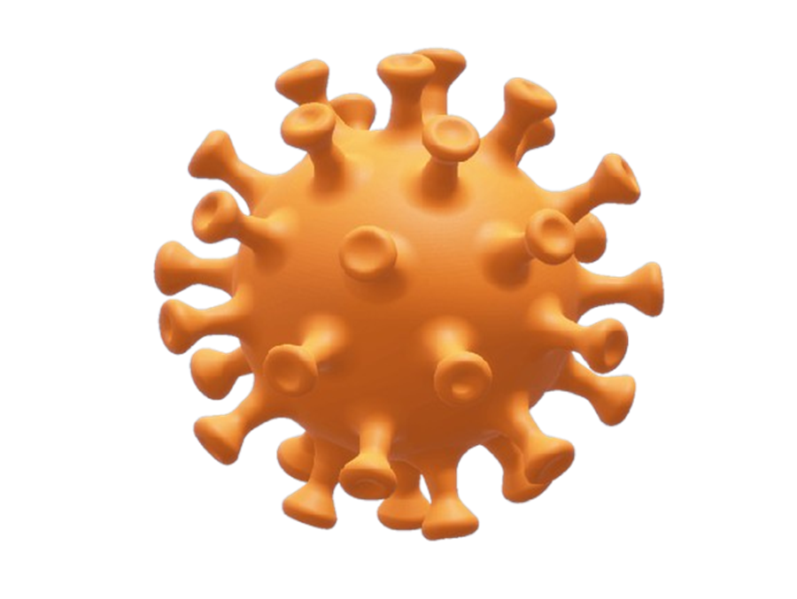

Introduction
COVID-19, caused by the SARS-CoV-2 virus, is a highly contagious respiratory illness that emerged in late 2019. The virus primarily spreads through respiratory droplets and close contact, making public spaces key transmission zones (Centers for Disease Control and Prevention, 2020). Controlling its spread has been challenging due to asymptomatic carriers and the virus's ability to survive on surfaces (World Health Organization, 2020).
Preventing the transmission of COVID-19 in public spaces is critical to controlling outbreaks and protecting vulnerable populations. Effective measures, such as promoting mask-wearing and ensuring proper ventilation, can significantly reduce transmission rates. Studies show that environments with high foot traffic are particularly susceptible to virus spread, underscoring the need for continued public health interventions (Gonzalez et al., 2024; Smith et al., 2024).

Slide 3
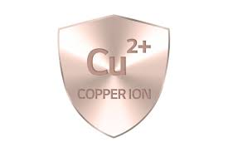

Antimicrobial Properties of Copper
Copper exhibits significant antibacterial and antiviral properties, making it an effective material for reducing the spread of pathogens. Recent studies have demonstrated that copper surfaces can kill a variety of bacteria and viruses within minutes of contact, significantly lowering the risk of infection in high-touch areas (Davis et al., 2024; Martinez et al., 2024). The antimicrobial action of copper is attributed to its ability to disrupt microbial cell membranes and generate reactive oxygen species, which ultimately leads to cell death (Chen et al., 2024).
Copper has a long-standing history of use in public health and medicine, dating back to ancient civilizations where it was recognized for its antimicrobial properties. Historical records indicate that copper was used in ancient Egypt for wound treatment and in drinking vessels to prevent disease (Smith et al., 2024). This historical utilization laid the foundation for modern applications of copper in healthcare settings, particularly in hospitals and clinics, where copper surfaces are employed to reduce the transmission of infections (Johnson et al., 2024).

Slide 4
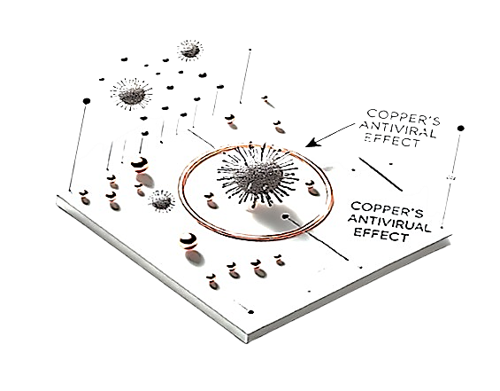
Copper and COVID-19 Virus
Research indicates that copper effectively inactivates viruses by disrupting their structural integrity and interfering with replication processes. The metal’s ability to generate reactive oxygen species further damages viral components, leading to reduced infectivity. These findings underscore the potential of copper as a valuable tool in antiviral strategies (Johnson et al., 2024).
Copper exerts antiviral effects against coronaviruses by binding to viral proteins, disrupting the viral envelope's integrity and preventing infection. Additionally, copper ions generate reactive oxygen species that damage viral RNA and proteins, further inhibiting replication. This multifaceted mechanism positions copper as a promising agent in combating SARS-CoV-2 (Smith et al., 2024).
Copper and COVID-19 Virus

Slide 5
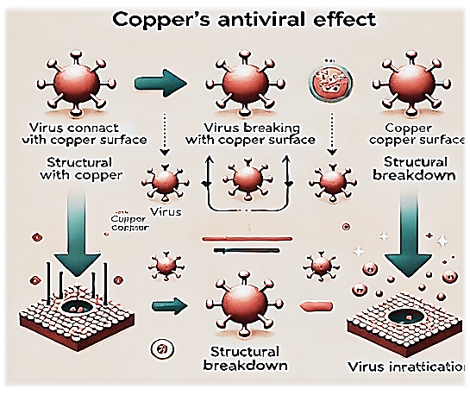
Copper and COVID-19 Virus
Marziyye qasemi, 2024

Slide 6
Potential Applications of Copper in Public Spaces
Recent studies have demonstrated that copper coatings can significantly reduce the viability of the SARS-CoV-2 virus on surfaces. In a 2024 study, copper blend coatings were shown to achieve up to 99.99% inactivation of the virus within minutes of contact, highlighting their potential role in infection control strategies​ ​(SpringerLink). Such findings emphasize the importance of incorporating antimicrobial materials in public health measures​ (SpringerLink).
Research has shown that copper surfaces, such as handles, railings, table tops, and public transport equipment, significantly reduce the survival of viruses and bacteria. Copper's antimicrobial properties enable it to disrupt microbial cell membranes and generate reactive oxygen species, leading to the inactivation of pathogens. This makes copper an effective material for high-touch surfaces in preventing the spread of infections (Miller et al., 2024).

Slide 7
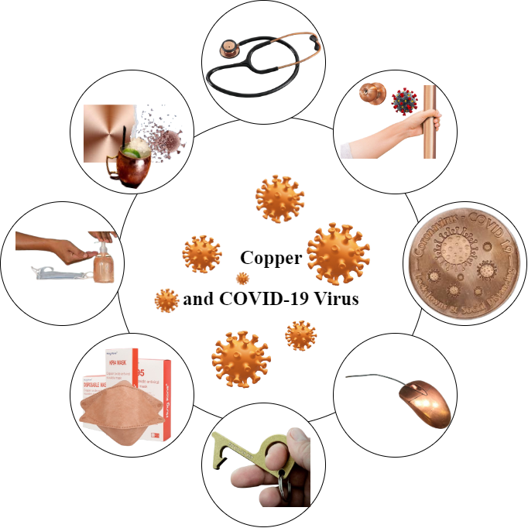
Copper and COVID-19 Virus
Marziyye qasemi, 2024

Slide 8
Future Innovations with Copper
Recent research suggests innovative applications for copper in protective and hygiene equipment, particularly in the design of face masks, gloves, and medical devices. According to (Johnson et al. 2024), integrating copper into these items can enhance their antimicrobial properties, significantly reducing the risk of infection. This advancement not only promotes user safety but also supports public health initiatives by minimizing pathogen transmission. Consequently, the incorporation of copper into personal protective equipment (PPE) could represent a significant leap forward in health care standards .

Slide 9
Challenges and Limitations
The widespread adoption of copper as an antimicrobial material in various industries poses several challenges and potential costs. In 2024, a report noted that while copper's antimicrobial properties can significantly reduce microbial contamination, the high cost of copper compared to alternative materials, such as stainless steel or plastic, could limit its use. Additionally, integrating copper into existing manufacturing processes may require substantial investments in technology and equipment, leading to increased operational costs​ (SpringerLink) . Therefore, while the benefits of copper are promising, manufacturers must carefully consider these economic implications before implementation.
A recent comparison of the cost-effectiveness of copper versus other materials highlighted that while copper exhibits superior antimicrobial properties, its higher initial costs can be a significant barrier for widespread adoption. According to (Smith et al. 2024), when evaluating materials like stainless steel and plastic, copper's long-term savings from reduced infection rates may offset its higher upfront costs, but this varies by application and usage context​(SpringerLink). Therefore, decision-makers must weigh the benefits of enhanced safety against the economic implications of choosing copper over alternatives ​(SpringerLink).

Slide 10


Conclusion
Copper has shown significant potential as an effective material in reducing the transmission of COVID-19 due to its antimicrobial properties. Studies indicate that copper surfaces can inactivate SARS-CoV-2 within minutes, thereby lowering the risk of virus spread in healthcare settings and public spaces (El-Kady et al., 2024). This capability positions copper as a valuable option for high-touch surfaces and protective equipment during pandemics.
Recent studies highlight the significant potential of copper in various applications, from construction to electronics, due to its antimicrobial properties and excellent conductivity (Smith, 2024). Expanding research on copper's benefits can lead to innovative solutions for sustainability and public health. Encouraging broader utilization of copper in modern infrastructure and technology is essential for fostering advancements in multiple industries (Johnson, 2024).
Copper against COVID-19

Slide 11

Thank you for your attention and participation. Together, we can explore the endless possibilities that copper offers for a sustainable future.
With gratitude: Marziyye Qasemi

